Slide 1
Validation Demo

Slide 2
What are Validations?
Validations are some rules set by the developer on input fields so as to satisfy the business rules for that particular input field in order to have the proper data in the system.
There are two types of validations:
Server side Validations
Client Side Validations
While performing validations we need to take care of not only the proper validation, but also ensure the validation meets the business rule as per the requirement. From a security perspective, it is often possible that some hackers may bypass client side validation and insert some vulnerable data to server.

Slide 3
Background
Different platforms have different ways of providing facility of validations. ASP.NET has validation controls with the help of which we can achieve the validations at server side. On client side we can achieve validations using JavaScript/jQuery. Nowadays there are many plugins which are used to carry out the client side validations. MVC framework supports server side and client side validations with inbuilt features. In MVC, validations have evolved since MVC 2. In MVC 2, there was support for Data annotations but MVC 3 introduced enhancements in Data Annotations for validations on server side and client side, as well as remote validations and compare attribute are added in MVC 3.0.
We will see the validations in MVC.Validations can be performed using the below methods.
Using ModelState Object
Using Data Annotation
Using Jquery
Custom validations can be applied to input fields using classes of MVC framework.

Slide 4
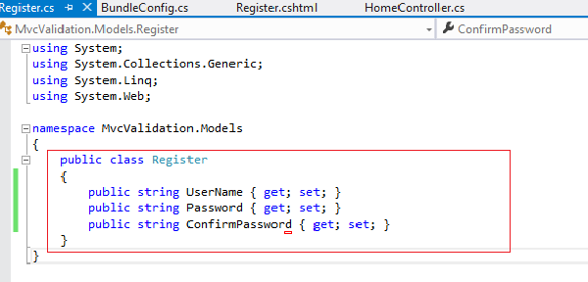
Server side Validations
Create an MVC project with name MVCValidationDemo
For this template, we have created one model Register.cs Let us look into Register.cs.

Slide 5
Making use of this model I will explain the basic server side validation.
Framework Validates all the fields of the model using ModelState object.
In code we need to check the IsValid property of the ModelState object.
If there is a validation error in any of the input fields then the IsValid property is set to false.
If all the fields are satisfied then the IsValid property is set to true. Depending upon the value of the property, we need to write the code.
The MVC framework provides the feature of data annotations for validations.
Data Annotation does all the above mentioned validations automatically and we need to only check the IsValid property.
We will do this server side validation without using data annotation attribute and using the ModelState Object.

Slide 6
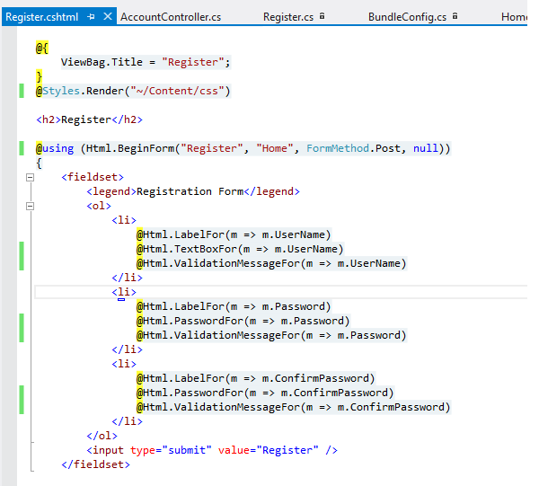
Using ModelState Object
We have created one view Register.cshtml with strongly typed model Register.cs

Slide 7
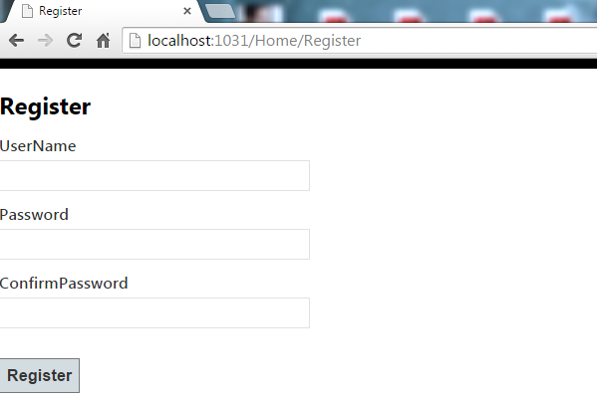
The Register view of the application will look like below

Slide 8
Now I will create one HTTPPOST method that will get hit once I click on the Submit button on Register view.
In this Register view, we will check whether the input properties in the model i.e UserName, Password and ConfirmPassword are Null/Empty. If those fields are Null/Empty then we will add error in ModelState object against that respective property.

Slide 9
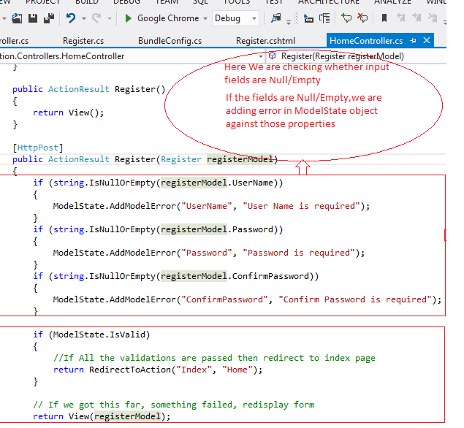

Slide 10
If I run the application and try to submit the register form with all the fields empty, then in the controller method, register model will get null values assigned to all the properties.

Slide 11
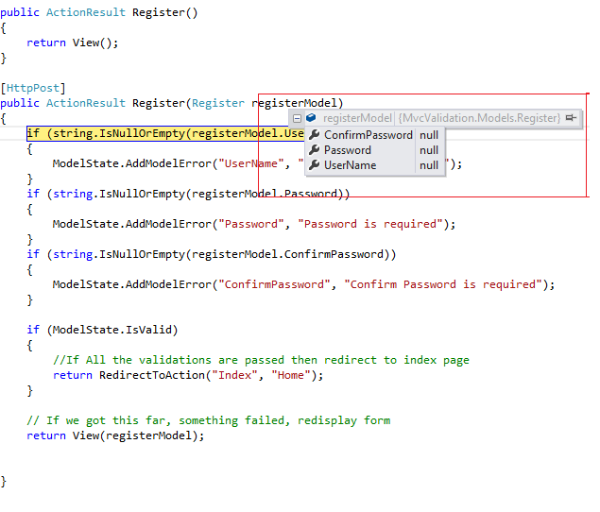

Slide 12
At the end of the execution ModelState Object will contain all the errors which are added for failed validation. Also the modelState object will contain the error message.
The view will look like the below with error messages.

Slide 13
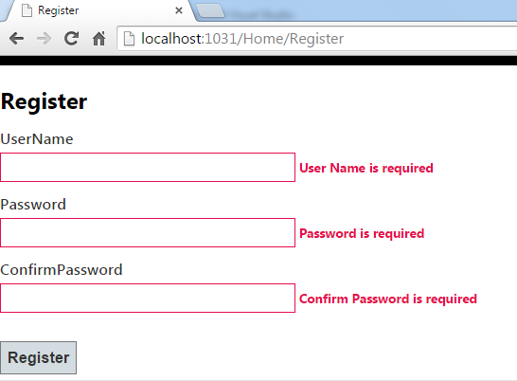
So this is a server side validation which is carried out without use of the data annotation attribute. We will see how data annotation makes the life of a developer very easy.

Slide 14
Data Annotation Attributes- Use
* DataType- This attribute specifies the type of the property like emailId OR phoneNumber.
[DataType(DataType.EmailAddress)]
public string Email { get; set; }
* Range- Specifies the maximum and minimum value for property.
[Range(1,100)]
public int Age { get; set; }
* RegularExpression-Specifies the valid value for property.
[RegularExpression(@"^\w+([-+.']\w+)*@\w+([-.]\w+)*\.\w+([-.]\w+)*$",
ErrorMessage="Please enter valid email id.")]
public string EmailId { get; set; }
* Required-Specifies that value of the property must be provided
[Required(ErrorMessage="Please enter First Name")]
public string FirstName { get; set; }

Slide 15
* StringLength- Specifies how many number of characters are allowed for that particular property.NULL value will not fire StringLength validation for that particular property.
[StringLength(50)]
public string FirstName { get; set; }
* Display This attribute is used to enhance the current property for which the attribute needs to be applied.
[Display(Name = "First Name", Description="First Name of the person")]
public string FirstName { get; set; }
* DisplayFormat This attribute is used to specify how the fields should be displayed and formatted
[DisplayFormat(DataFormatString = "{0:C}")]
public Decimal ListPrice { get; set; }

Slide 16
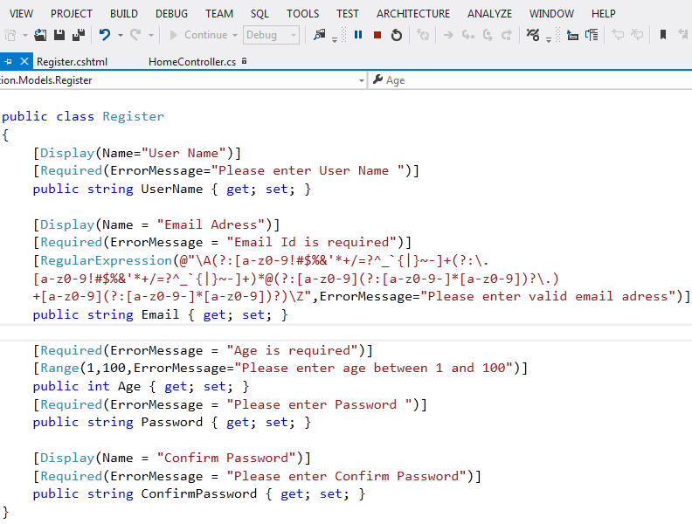

Slide 17
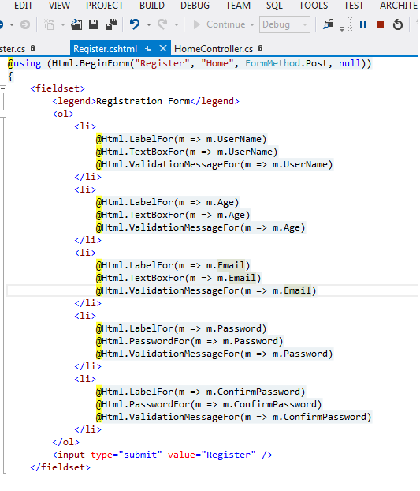
View

Slide 18
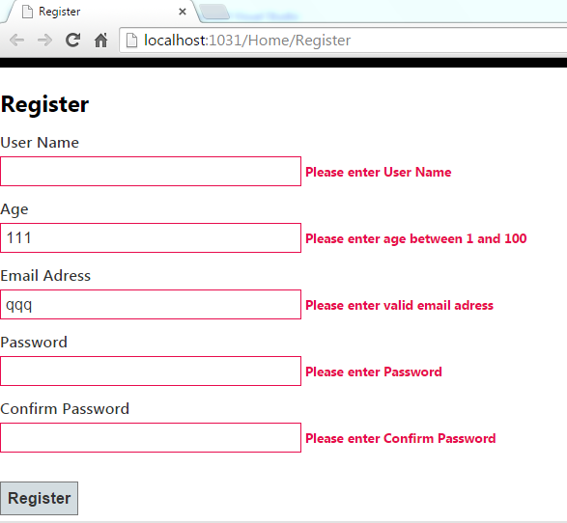
Output

